Slide 1
Sensor Pod Configuration at TFRI with PRIME Week 1
Thaddeus Trinh
06/27/13

Slide 2
Proposed Research
To work with TFRI to help integrate new sensors into their Android sensor pod network and to deploy and test the new sensors in the field

Slide 3
Overview of First Week
Worked on editing the sensor pod code to add capabilities for a Fuel Moisture Sensor
Worked on a powerpoint to use at the TFRI workshop that will help workshop attendees learn to use the sensors for their own purposes

Slide 4
Fuel Stick
One of the main goals of my PRIME Project is to integrate a fuel moisture sensor into the sensor pod and to help with the deployment
So far in this first week I have finished editing the sensor pod android code to add the fuel stick

Slide 5
TFRI Workshop
From July 1 – July 5, UCSD and TFRI will be hosting a joint workshop to help other environmental researchers learn how to use and integrate the sensor pod into a myriad of environments
I will be assisting Peter Shin in helping to teach many of the workshop attendees on how to assemble the circuit board used in the sensor pod and how to edit the android code for their own purposes

Slide 6
Upcoming Goals
By next week, I hope to finish integrating the Fuel Stick onto the Android Sensor Pod
One of the main obstacles in accomplishing this goal is finding the proper cables to connect the sensor to the board

Slide 7
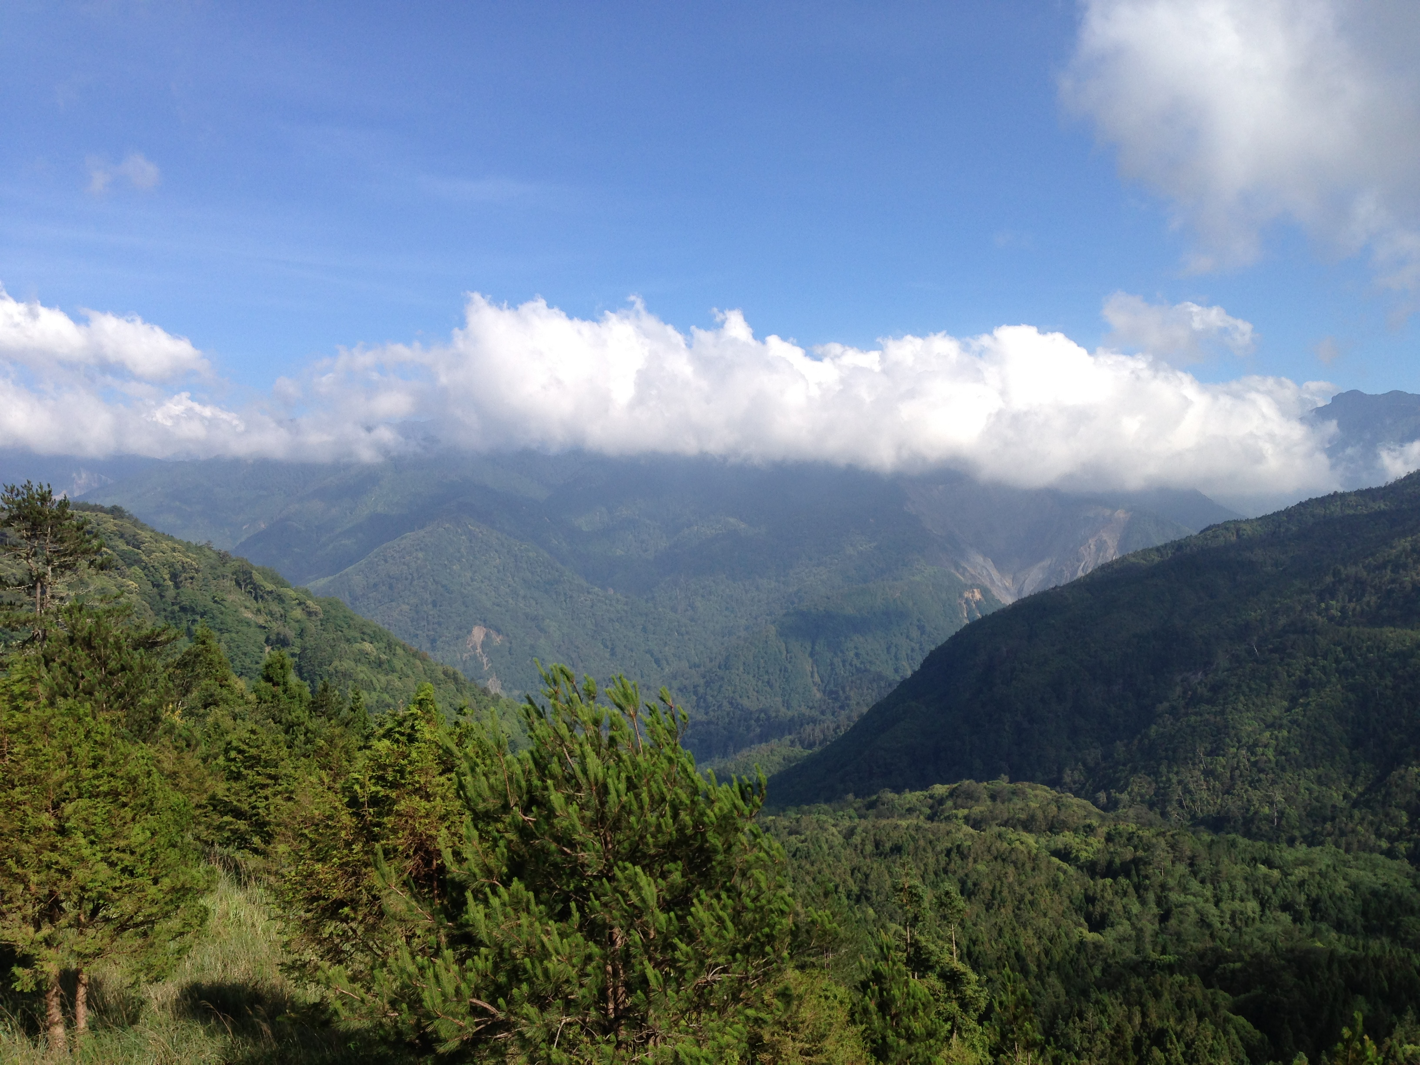
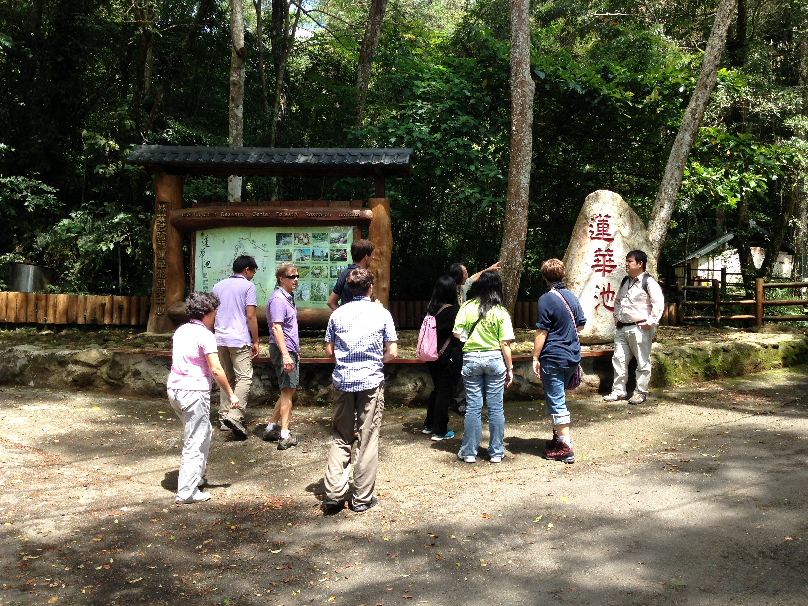
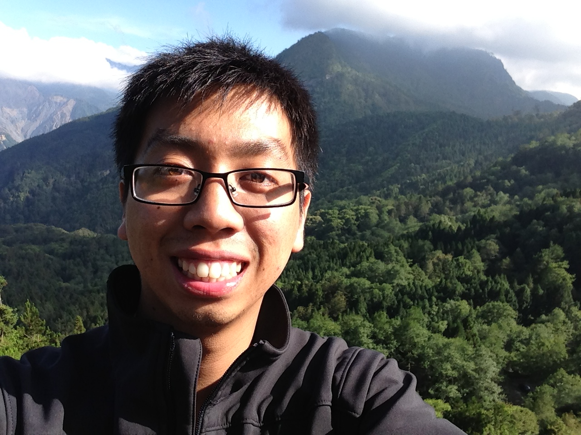
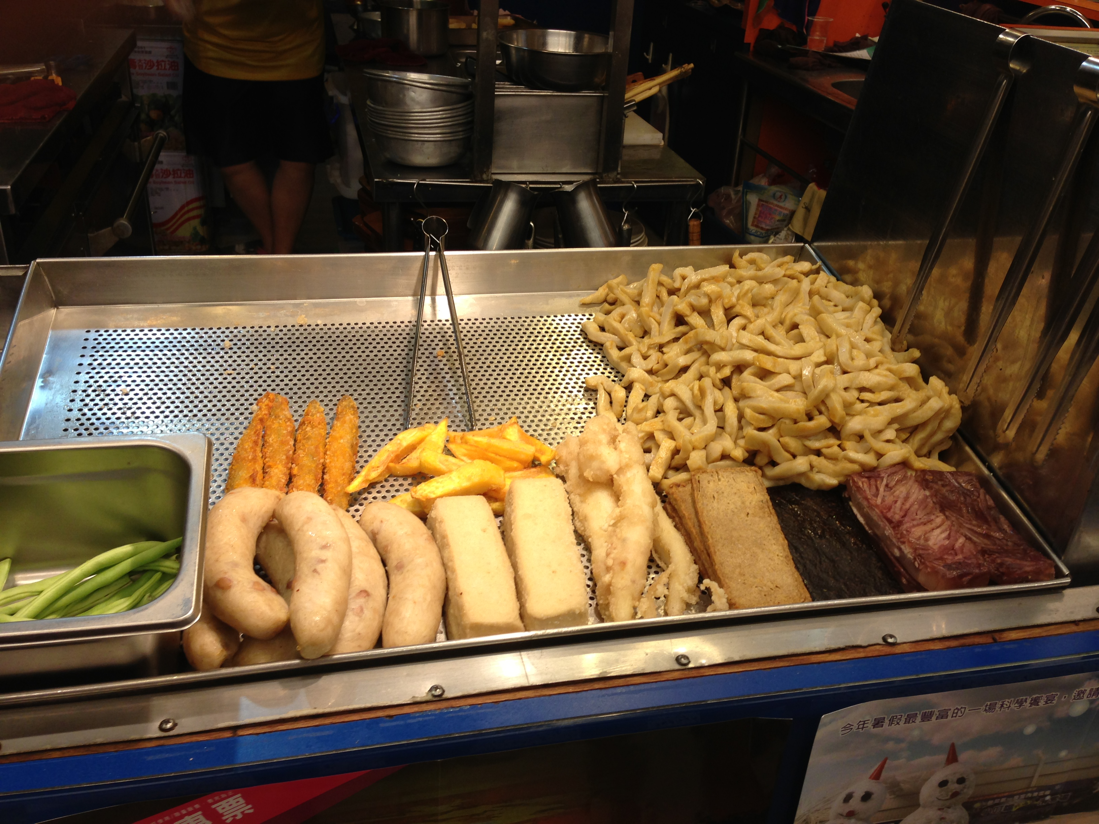
Taiwan

